Slide 1
Mini Project Expense Tracker
By
Dhruva Sandu – PB55 (PRN:1032211460)

Slide 2
Introduction
The Expense Tracker is a user-friendly web application that streamlines expense management.
It facilitates efficient tracking of financial events, expense creation, and maintenance of past financial records.
Leveraging modern web technologies, the project aims to simplify budgeting and spending processes.
Objectives :
The Expense Tracker project is developed to offer users a robust financial management tool, enabling efficient expense tracking and organization of events with set budgets.
The project strives to simplify budgeting, empower users in financial decision-making, and maintain an organized financial history.

Slide 3




Frontend Technologies Used
React.js
React Router
Redux
Axios
JavaScript library for building UI components.
Navigation library for React applications.
State management library for React applications.
HTTP client for making asynchronous requests.

Slide 4




Backend Technologies Used
Node.js
Express.js
MongoDB
Mongoose
JavaScript runtime for server-side development.
Web application framework for Node.js.
NoSQL database for storing and retrieving data.
MongoDB object modeling for Node.js.

Slide 5
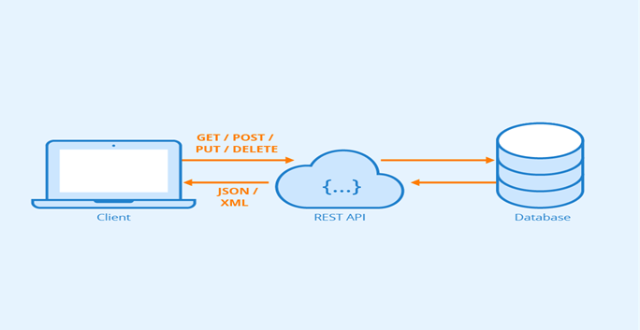
Middleware r
CORS:
CORS, or Cross-Origin Resource Sharing, is a security feature implemented to control how web pages in one domain can request and interact with resources hosted on another domain.
In the context of our project, which involves both frontend (React.js) and backend (Node.js with Express.js) components, CORS is essential for handling requests across different origins.

Slide 6
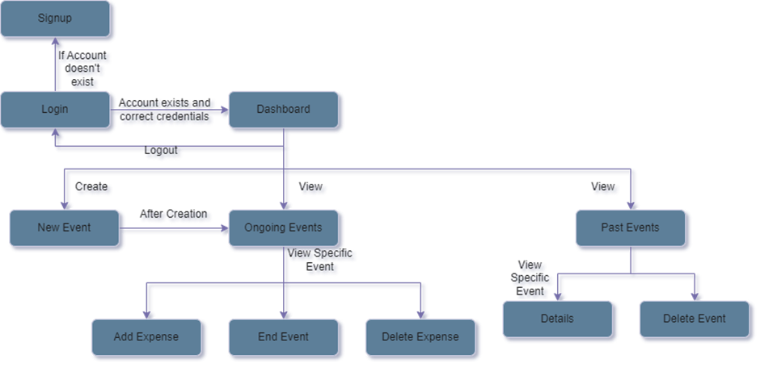
Workflow Diagram

Slide 7
Workflow
1. User Authentication:
Users sign up or log in.
Node.js/Express.js handles authentication with MongoDB.
2. Dashboard:
React.js implements the dashboard.
Users navigate ongoing/past events and create new ones.
3. Creating a New Event:
Users add events, and the server stores data in MongoDB.
4. Ongoing Events:
View ongoing events and remaining budgets.
Frontend requests ongoing events data from the server.
5. Event Details:
View detailed event info, add/delete expenses.
React.js frontend communicates with the server for data.
6. Adding Expenses:
Users update remaining budgets by adding expenses.
Frontend sends API request; server updates MongoDB.
7. Past Events:
View past events with React.js API requests.
8. Deleting Past Events:
Delete events, triggering expense deletion.
Frontend requests server; server updates MongoDB.
9. Logging Out:
Users log out; React.js updates Redux state.

Slide 8
Real-time Collaboration Features
Future Scope
Mobile App Development
Enable participants to share updates instantly.
Expand accessibility with iOS and Android apps.
Expense Reports & Analytics
Financial Services Integration
Generate detailed reports, visualize spending patterns.
Automate processes, integrate payment platforms.

Slide 9
Conclusion
The project is a React.js frontend, Node.js/Express backend, and MongoDB storage, streamlining event budget management.
It uses RESTful APIs, Redux for state management, targeting improved user authentication, real-time collaboration, advanced analytics, mobile app development, and financial service integration.
The goal is to enhance user experience and offer sophisticated tools for event planning and financial management.

Slide 10
Thank You!

Slide 11
References
https://www.geeksforgeeks.org/how-to-connect-mongodb-with-reactjs/
https://www.geeksforgeeks.org/nodejs/
https://stackoverflow.com/
https://react-redux.js.org/introduction/getting-started
https://www.tutorialspoint.com/expressjs/index.htm
https://www.geeksforgeeks.org/mern-stack/
https://www.geeksforgeeks.org/know-the-difference-between-rest-api-and-restful-api/
https://www.scaler.com/topics/nodejs/cors-in-node-js/
https://expressjs.com/en/resources/middleware/cors.html

